Slide 1
Direct Absorbance Bilirubin Spectrometer (DABS)
Group 4 – Spring 2020
Bernardin Dezius, CpE
Juan Gonzalez, EE
Kevin Kuzius, EE
Kevin Landau, PSE
Andrea Wetteland, PSE

Slide 2
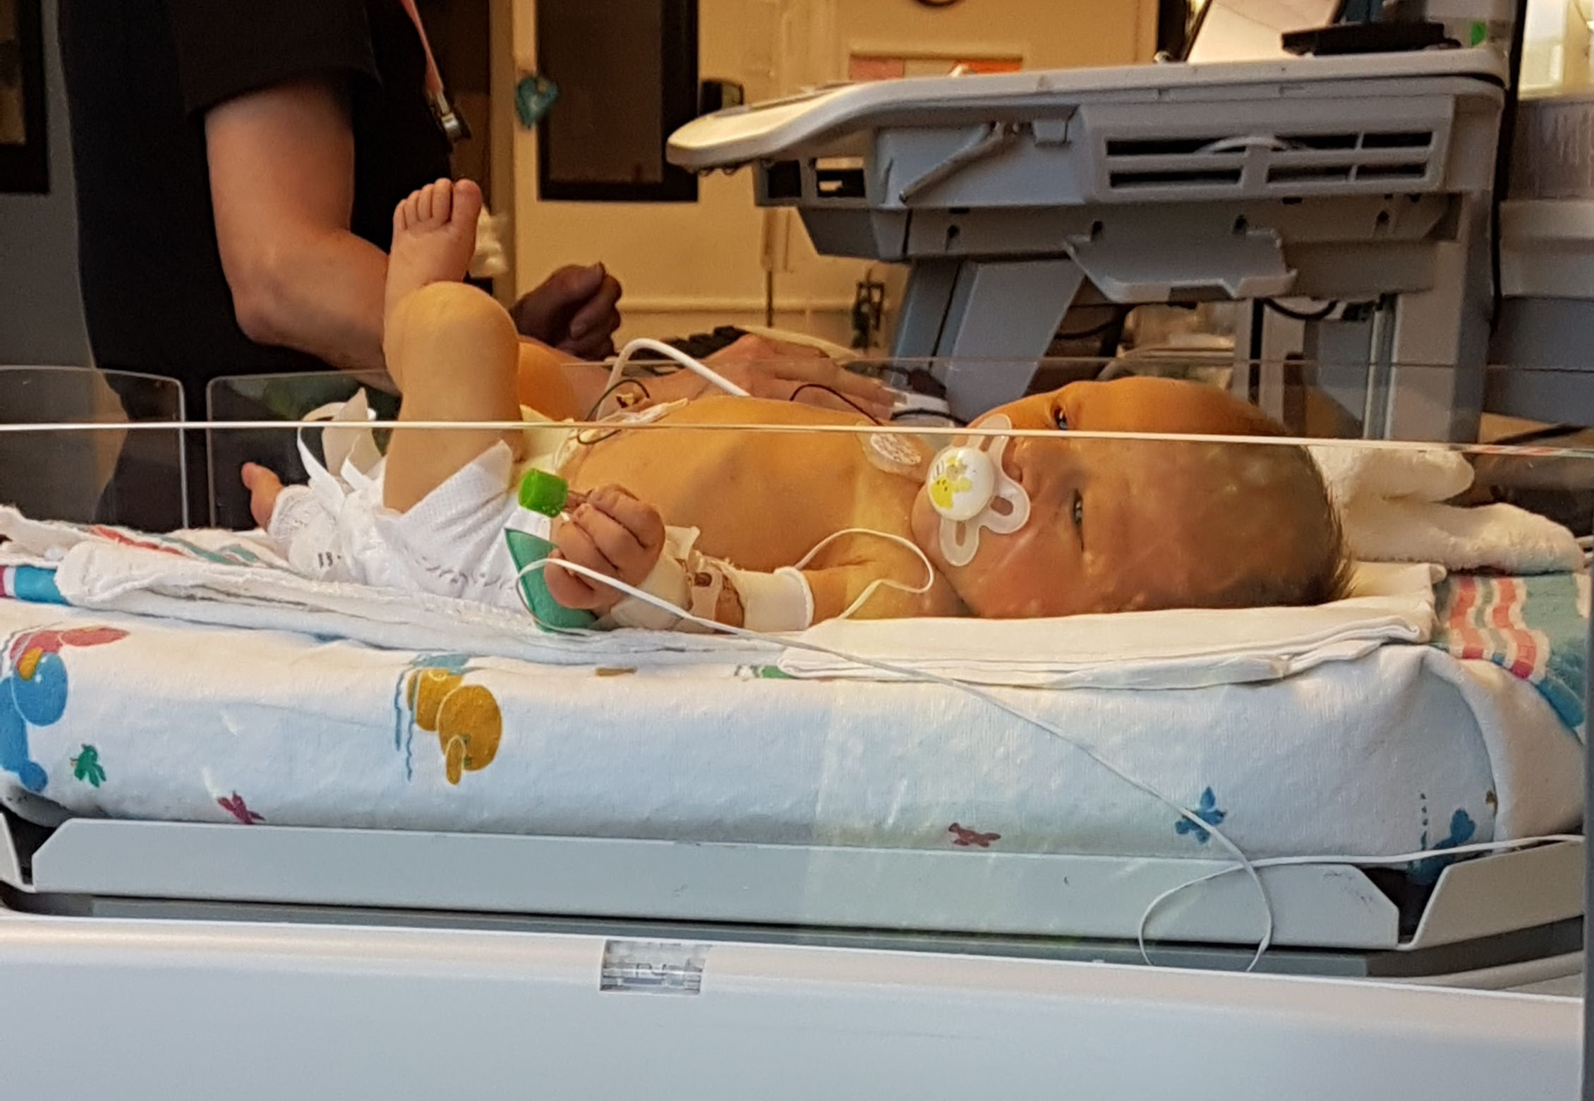
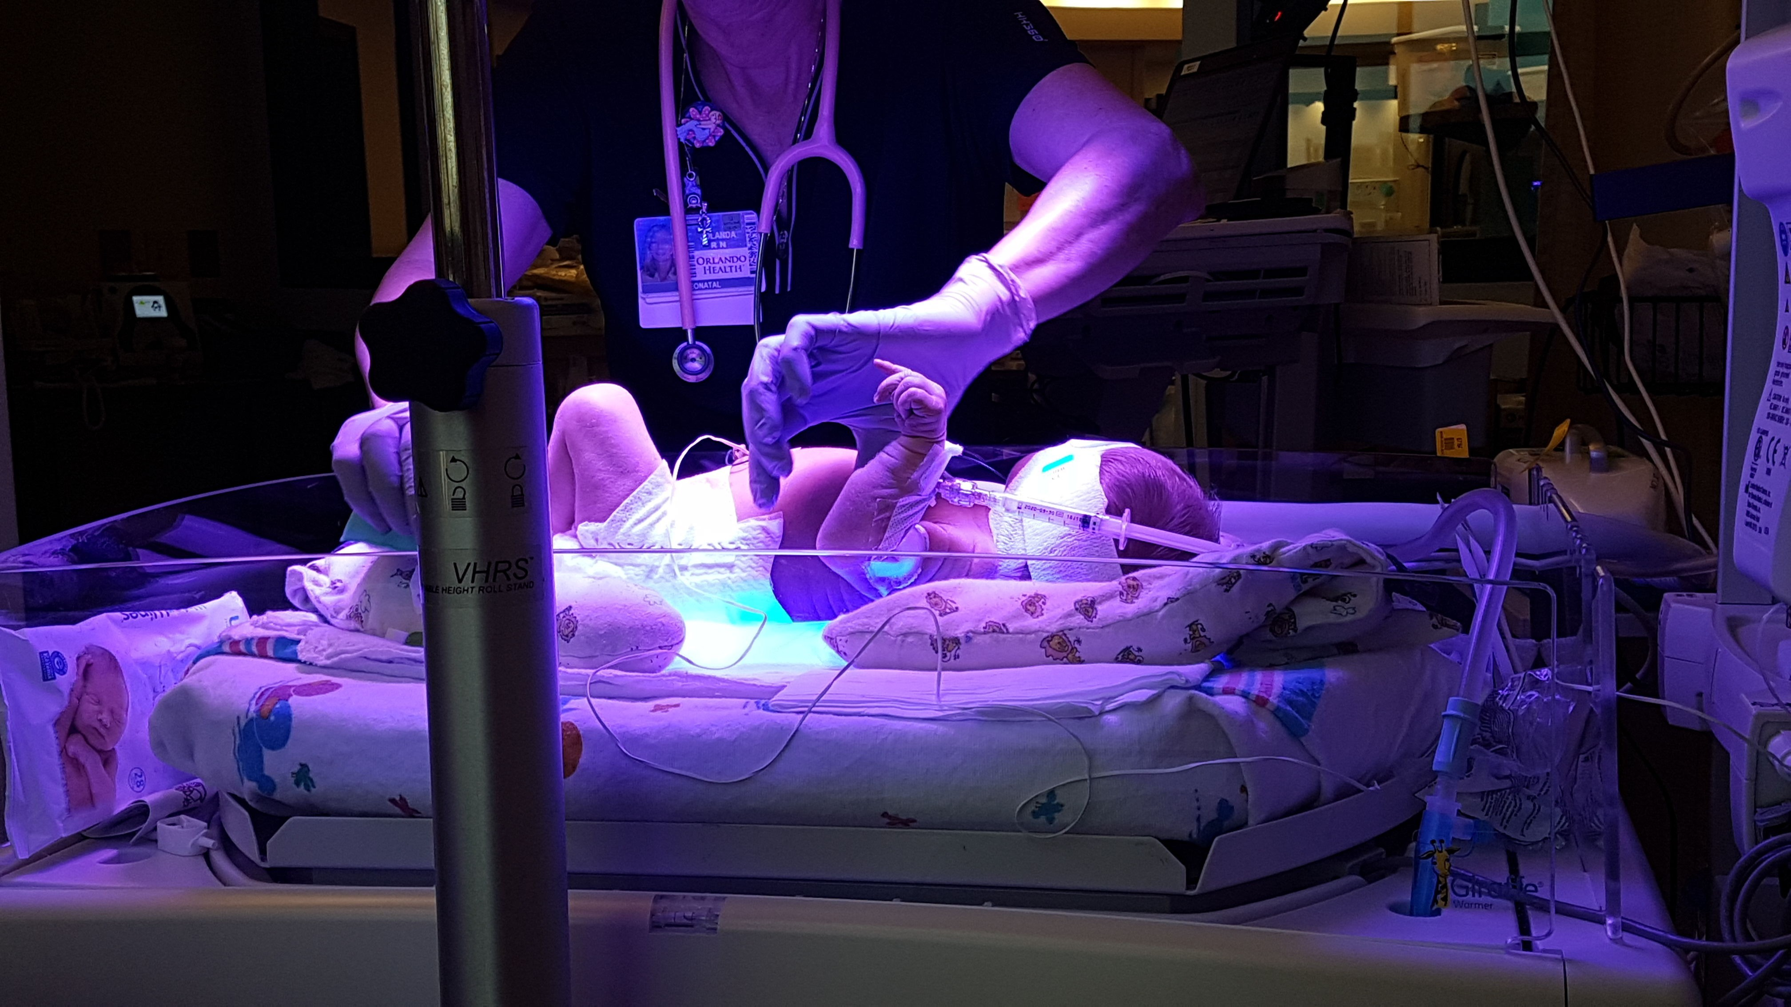
Motivation
Jaundice is a build-up of bilirubin the blood that the newborn's liver can't efficiently filter. Although most cases are mild and can be treated with exposure to sunlight, higher levels can cause brain damage if not treated. Most severe cases don't begin developing until the third day, after most infants are discharged from the hospital, and go undetected until the infant's first scheduled checkup.
One year ago, a team member's 3-day newborn son began turning yellow. Jaundice afflicts up to 60% of all newborns, so it was uncertain whether his jaundice was normal or needed urgent attention. At the 1-week appointment, blood tests indicated bilirubin levels were severe and he spent the next 3 days being treated with phototherapy in the NICU.

Slide 3
Goals & Objectives
The goal of this project is to provide a quick, safe, and cost-effective medical tool in determining high levels of bilirubin in newborns.
Using natural pigments betalain and curcumin as proxy hemoglobin and bilirubin, the DABS device can be calibrated for use with real whole blood serum with minimal alterations.
DABS device is for clinical use that can quickly determine whether the concentration of curcumin in betalain solution corresponds to equivalent bilirubin absorbance values of safe, elevated, and dangerous.
DABS can be used for quick, inexpensive in-clinic screening for jaundice severity.

Slide 4
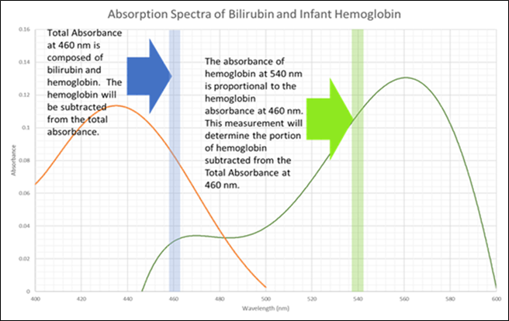
How does it work?
•Bilirubin and hemoglobin contribute to the absorption measured with a blue wavelength.
•Only hemoglobin contributes to the absorption at 540 nm.
•Based on hemoglobin and oxygen levels in a normal, full-term neonate, the hemoglobin absorption at 540 nm can determine the amount of absorption is due to hemoglobin at 460 nm.

Slide 5
Operation
4 inputs needed:
405 nm blank cuvette
532 nm blank cuvette
405 nm sample cuvette
532 nm sample cuvette
A transimpedence op amp will convert the current readings from a photodiode to a voltage value that can be recorded by the MCU.
User will insert a blank cuvette and the voltage will be taken at blue and green
User will then be prompted to insert the sample cuvette and the voltage values recorded.
MCU will calculate absorbance due to curcumin and determine whether the curcumin concentration is "safe", "elevated", or "dangerous".

Slide 6
Specifications
# | Specifications | Description
1 | USB | USB must supply at least 5 Volts for device usage
2 | Battery Life | Device must last greater than 1 hour of continuous use
3 | Light Source | 5 mW 532 nm green laser and 405 nm blue laser diode
4 | Dimensions | The device should measure no more than 10 x 9 x 9"
5 | PCB | PCB should be < 12 x 12 cm
6 | Sample Size | Sample size must be 3 - 4 mL
7 | Optical Sensing Accuracy | Determine 3 boundary ranges of concentrations (Safe, Elevated, Dangerous)
8 | Weight | The device should weigh < 50 lbs
9 | Testing of sample | Testing of sample should last no longer than 10 minutes
10 | Cooling system | Device should be maintained at room temperature (25 ℃ ± 5%)
11 | Cost | This device should cost less than $1000

Slide 7
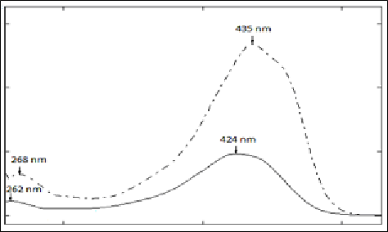
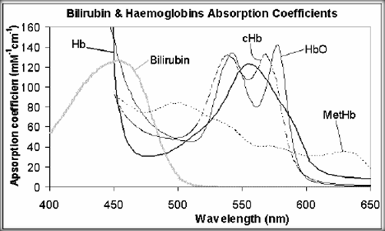
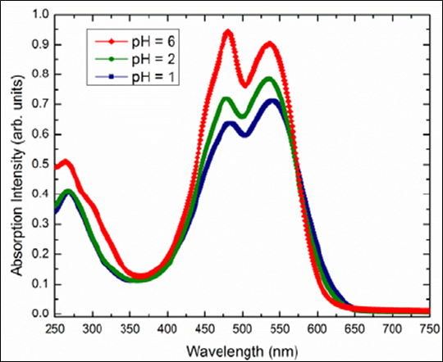
Proxy Samples
Bilirubin
Curcumin
Hemoglobin
Betalain

Slide 8
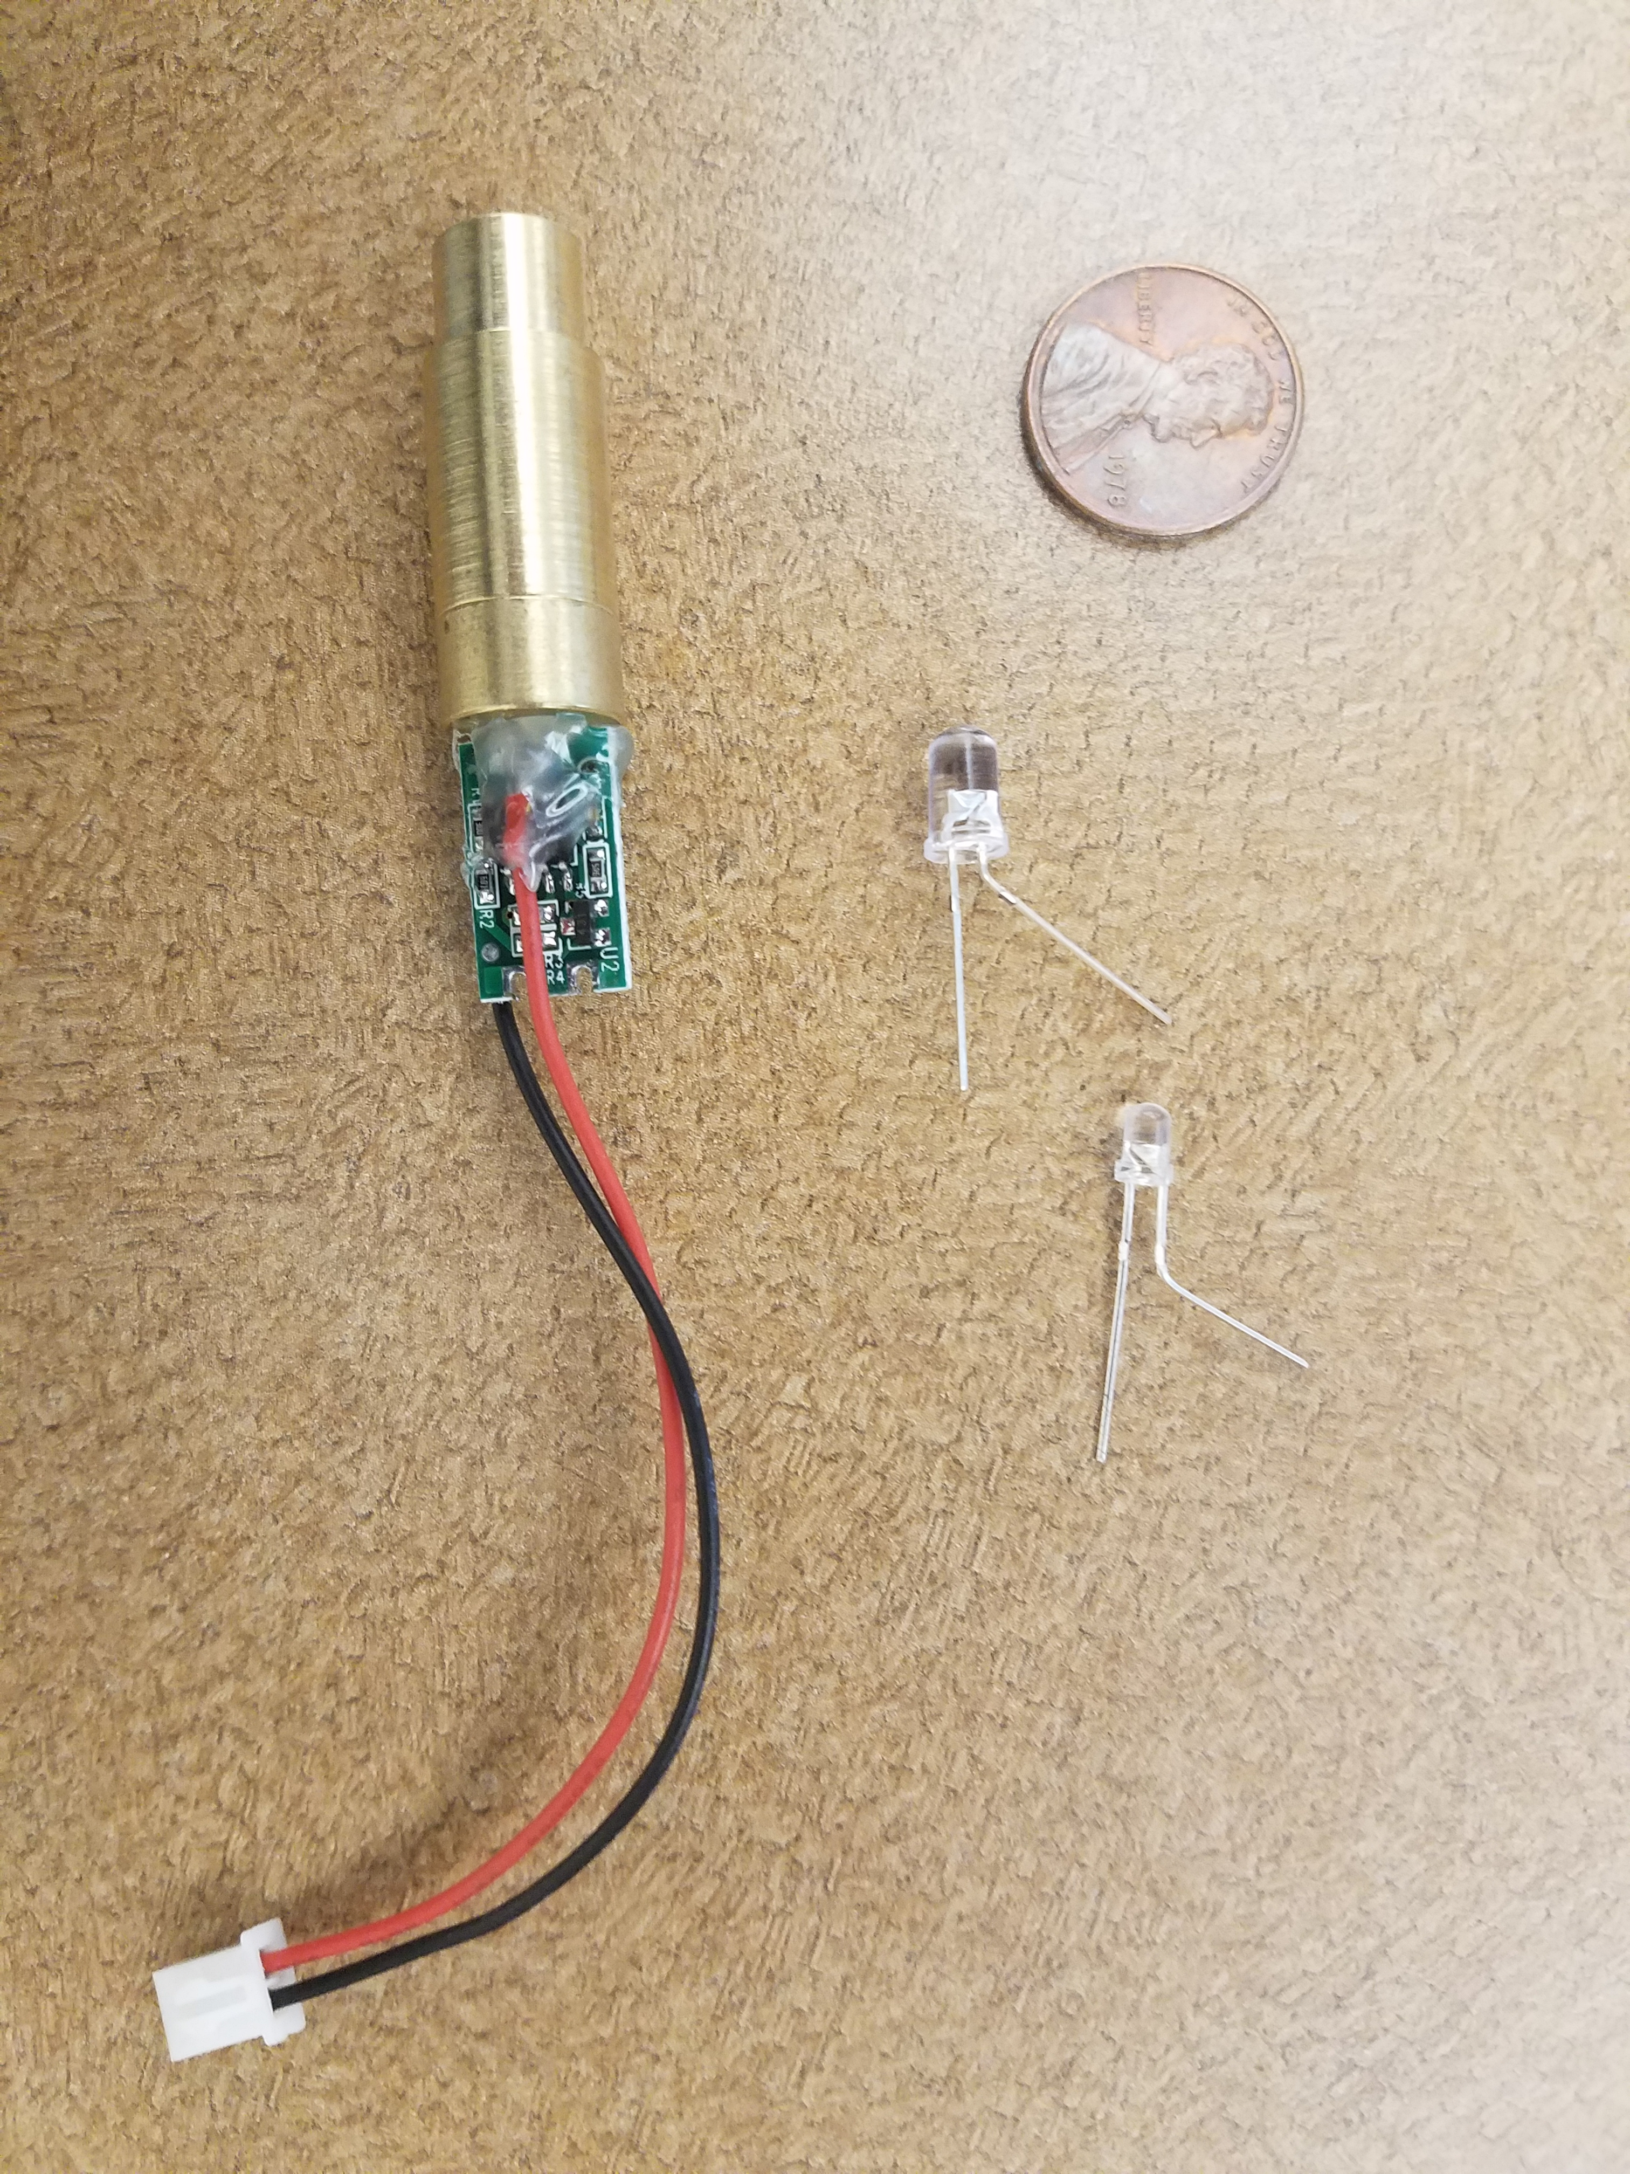
Light Sources
Requirements
•Power requirements: ~4 V
•Power output: 5 mW
•Wavelength output: ~405 nm, ~532 nm, with low FWHM
•Low-cost
Laser Diodes vs LEDs
•LEDs cheaper, more efficient
•Laser diodes have much narrower FWHM range

Slide 9
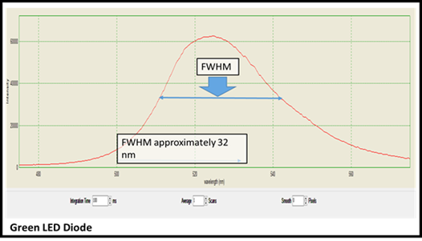
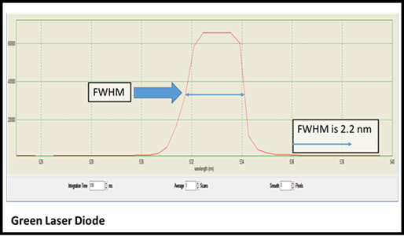
FWHM Spectral Emissions
•A wide spectral width makes it almost impossible to attribute amounts of absorption to specific wavelength ranges.
•Equal and specific spectral widths for each wavelength are necessary to accurately determine absorption

Slide 10
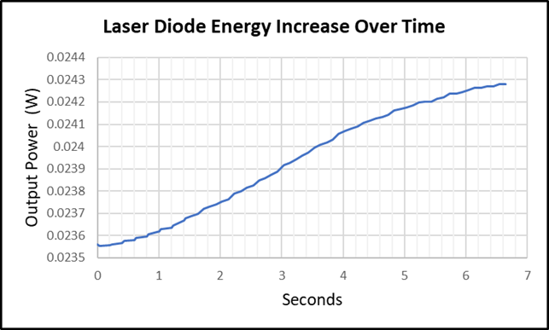
Lasers – Temperature Requirements
•The power output should be the same for the blank and the transmitted readings
•Reading at 1 sec before slope begins to increase
•Purpose of fan to mitigate this temperature increase

Slide 11
Photodetector
Convert optical signal to an electrical signal
High sensitivity
Spectral range that includes 405 nm and 532 nm
Linear response
Use Beer-Lambert Law to calculate the concentration of the desired substance

Slide 12
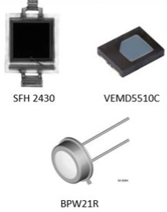
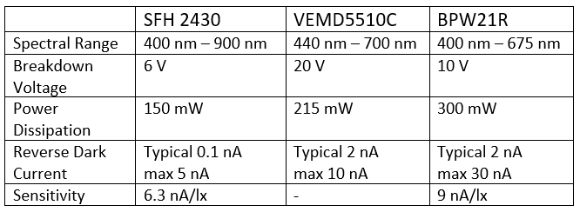
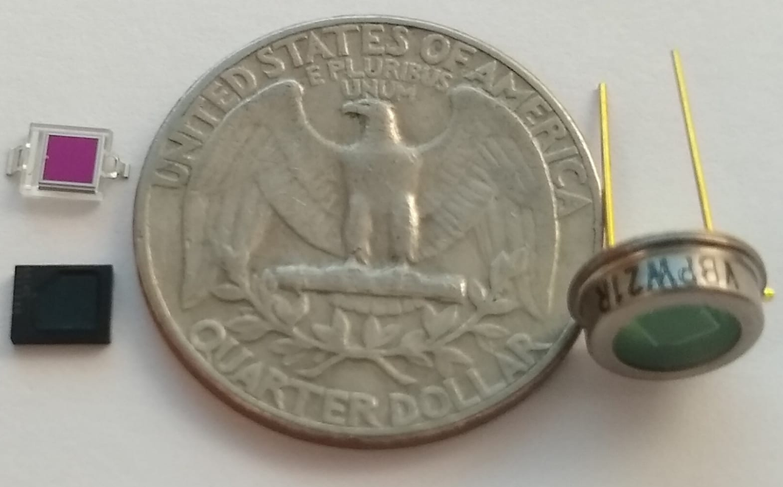
Detector Comparison
Size Comparison

Slide 13
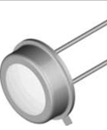
Detector – BPW21R
•This detector had the highest sensitivity (9 nA/lx) and a narrow spectral range
•Linear response
•Ease of use for testing and implementation into the circuit
•Larger radiant sensitive area 7.5 mm² as opposed to 7.02 mm²

Slide 14
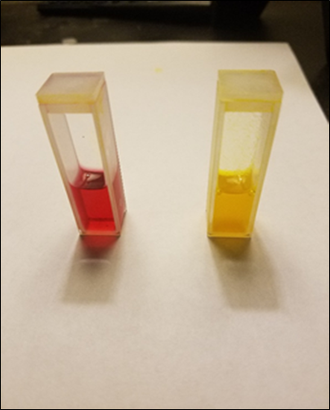
Sample Preparation
Jaundice is diagnosed in clinics based on absorption values in whole blood serum:
Lower than .5 is "safe"
Between .5 and 1.4 is "elevated"
Higher than 1.4 is "dangerous"
Turmeric was soaked in 100% isopropyl alcohol until curcumin concentrations of .5 and 1.4 absorption values were achieved at 405 nm.
1 mL of curcumin solution was added to 2 mL betalain solution. The calculated absorbance values, .365 and .478, became threshold values.

Slide 15
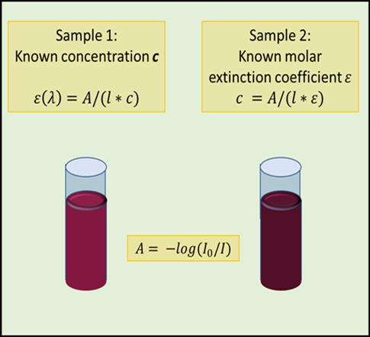
Calculating Absorbance
• Beer-Lambert Law
A = lcε = log(I₀/I_{T})
• Comparison of incident (blank) to transmitted
• Hold separate curcumin and betalain concentrations constant to find ε for each wavelength.
• Use ε coefficients to calculate unknown concentrations
$$A=\log\left(\frac{I_{0}}{I_{T}}\right)$$

Slide 16
Betalain Absorbance at 405 nm
The graph shows the trendline between the measured values of absorbance under 532nm vs 405nm
The slope of 0.9281 allows us to determine the expected absorbance attributed specifically to betalain when the unknown samples are illuminated under 405nm light

Slide 17
Preliminary Results
Sample # | I_{532nm} (mA) | T_{532nm} (mA) | A_{532nm} | A_{B405nm} | I_{405nm} (mA) | T_{405nm} (mA) | A_{405nm} | A_{405nm} -A_{B405nm}
1 | 2.15 | 0.203 | 1.024942 | 0.951249 | 3.17 | 0.141 | 1.35184 | 0.40059
2 | 2.16 | 0.203 | 1.026958 | 0.953119 | 3.1 | 0.216 | 1.156908 | 0.20379
3 | 2.15 | 0.195 | 1.042404 | 0.967455 | 3.1 | 0.221 | 1.146969 | 0.17951

Slide 18
Transimpedance Amplifier – OPA170
Referenced Texas Instruments “Analog Engineer’s Circuit Cookbook: Amplifiers” to select this amplifier
OPA170 fit our design
Recommended for use in many sensors
Single supply range from 2.7 to 36 V, we used 3.3
Unity gain factor - set the circuit gain with feedback resistor

Slide 19
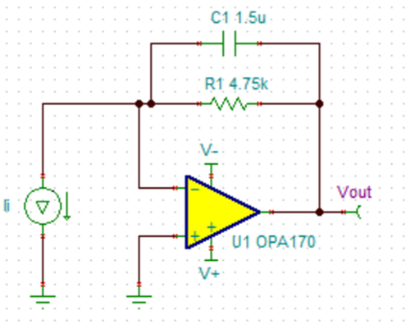
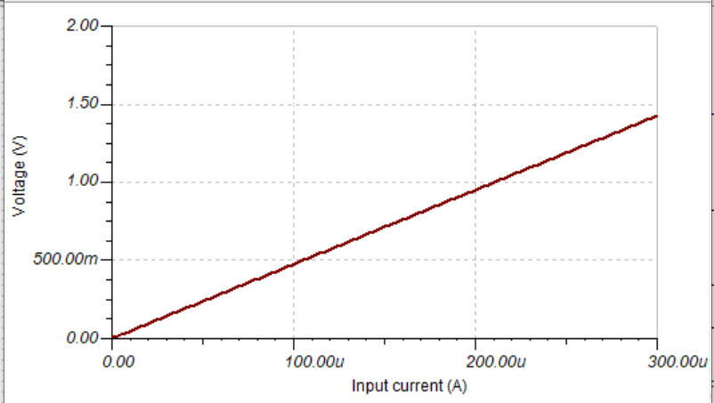
Amplifier Testing – Schematic Capture
First: Using TI TINA Schematic Capture Tool
Determine theoretical gain

Slide 20
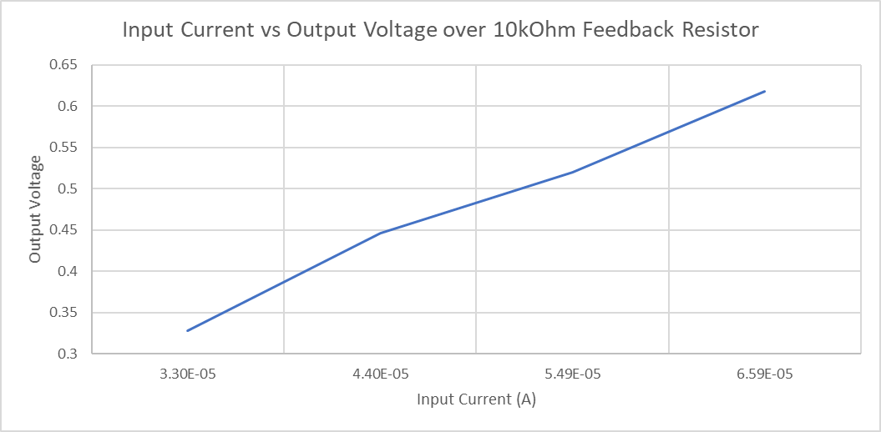
Amplifier Testing – Breadboard Circuit
Contacted DigiKey Support to find a comparable through-hole package amplifier
TI OPA241- a unity gain transimpedance amplifier

Slide 21
Microcontroller Technology Comparison
Parameter | MSP430FR6989 | MSP432P4111 | Atmel SAM3X8E ARM Cortex-M3
GPIO | 63 programmable (80pin) 83 programmable (100pin) | 84 programmable | 54 Digital 12 Analog Input 2 Analog Output
ADC Resolution | 12 Bit | 16 Bit | 12 Bit
Clocking Features | 16 MHz (max) | 48 MHz (max) | 84 MHz (max)
Memory (Flash) | 128 KB | 2048 KB | 512 KB

Slide 22
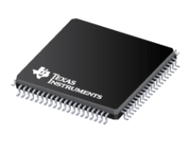
Microcontroller
Coordinates all operations
Stops modules from conflicting and wasting power
Low-power modes
Actual Size: 14mm x 14mm
Texas Instruments

Slide 23
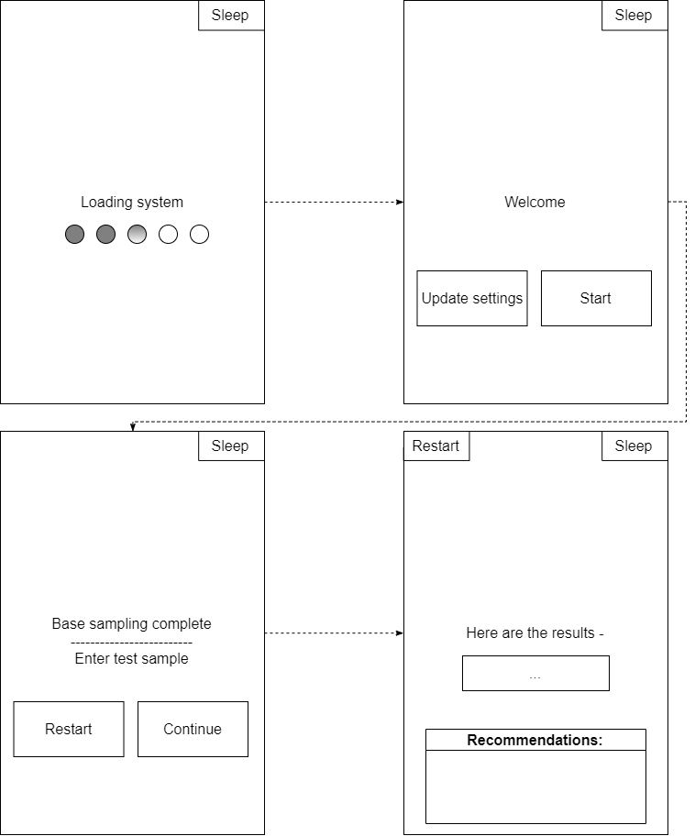
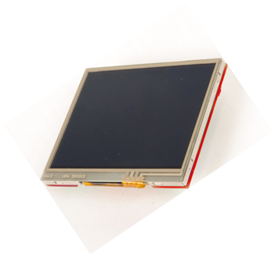
User Interface
BOOSTXL-K350QVG-S1
From Texas Instruments
~ $24.99

Slide 24
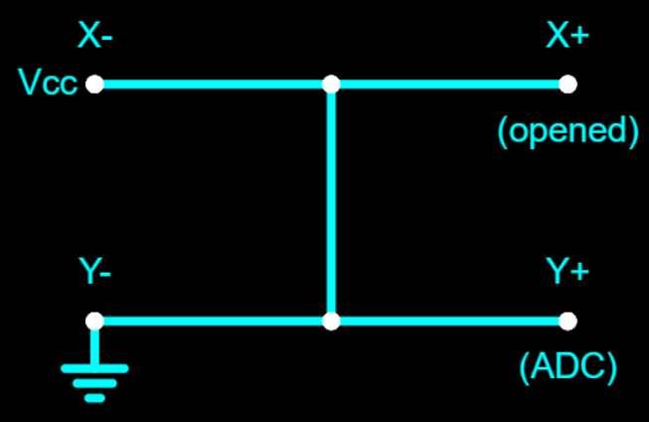
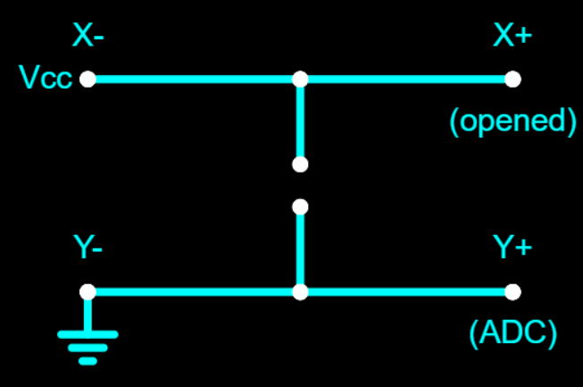
Display’s consumption
Internal circuit, turns off display
Touchscreen - sampling driven by touch interrupt

Slide 25
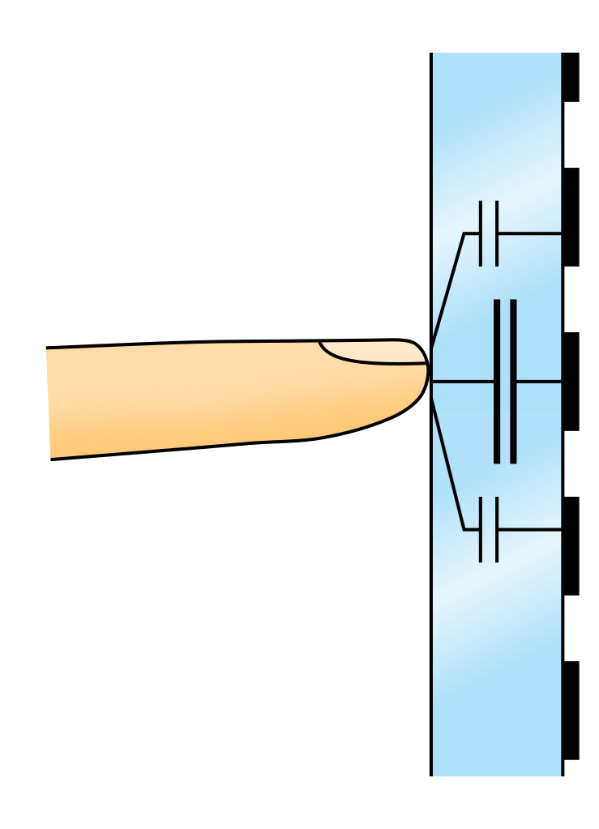
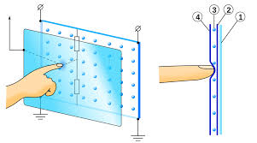
Touchscreen – Capacitive vs. Resistive
Resistive
Capacitive
Non multi-touch
Usable with gloves
Stylus compatible
Less sensitive to touch
Less expensive
Lacking in display quality
Multi-touch
Unusable with most gloves
Stylus incompatible
Sensitive to touch
More expensive
Responsiveness can vary per implementation in various products

Slide 26
Flowchart

Slide 27
Use Case Diagram

Slide 28
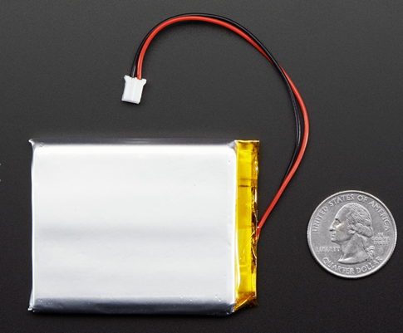
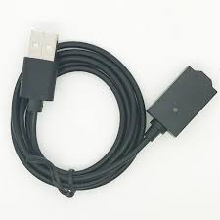
Power Input
Lithium-Ion Battery:
4.2 V Max / 3.7 V nominal
2500 mAh capacity (10 Wh)
Adafruit - $14-15
USB Connection:
5 V Output
Will be used to charge the battery
Will supply power to the system when the battery is charging

Slide 29
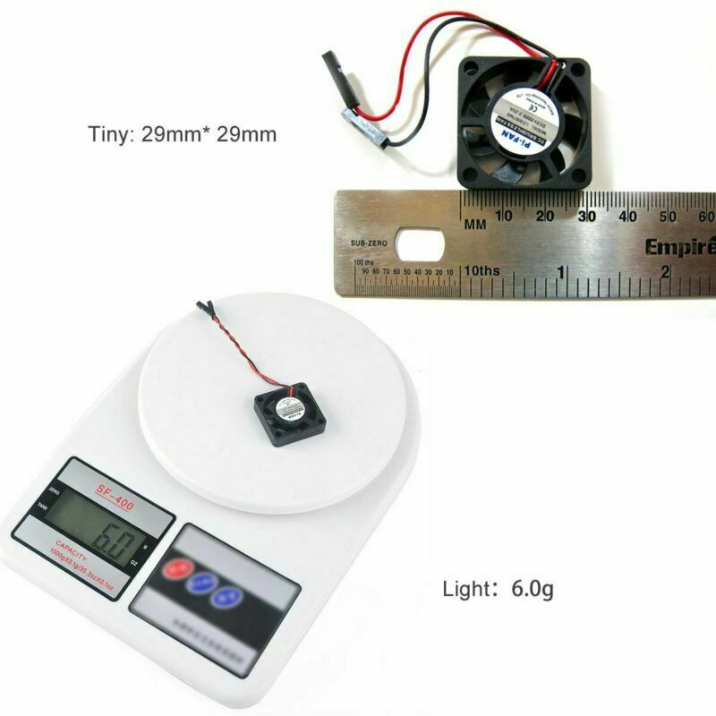
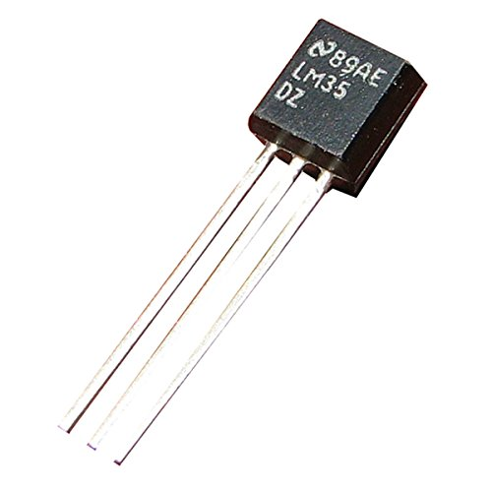
Other Components
Brushless Cooling Fan (x2)
Rated Voltage of 3.3 or 5 V
13000 RPM
180 mA
Amazon - $8
Temperature Sensor (TI LM35)
4 – 30 V
Range of -55°C to 150°C
< 60 uA current draw

Slide 30
Battery Charging- TI’s MCP73831

Slide 31
Power Switching Schematic
USB Connection
(5V)
System
Battery

Slide 32
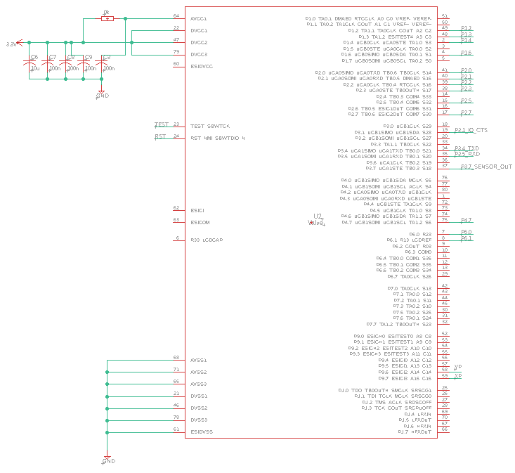
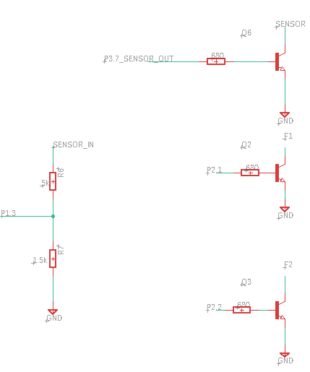
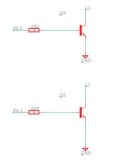
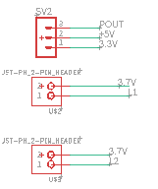
PCB Schematic
MCU-MSP430FR6989

Slide 33
PCB Schematic
LCD I/O

Slide 34
PCB Schematic
To Emulator on TI MSP430 Launchpad

Slide 35
PCB Schematic
Cooling System
I/O

Slide 36
PCB Schematic
Optical Connections
Laser (2)
Photo Detector

Slide 37
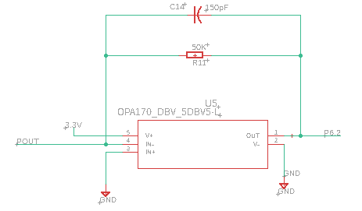
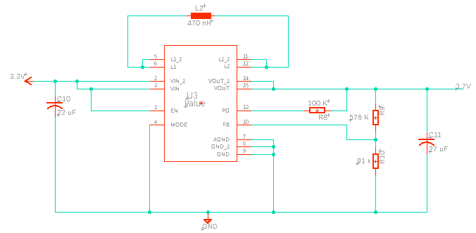
PCB Schematic
Amplifier Circuit

Slide 38
PCB Schematic
DC-DC Converters

Slide 39
PCB Schematic
Battery Charging Circuit

Slide 40
PCB Layout
Vendor: JLC PCB
Cost: ~$20 (includes shipping cost)

Slide 41
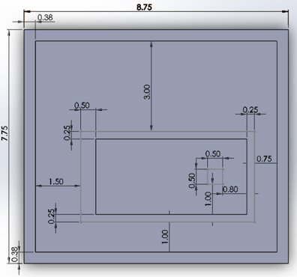
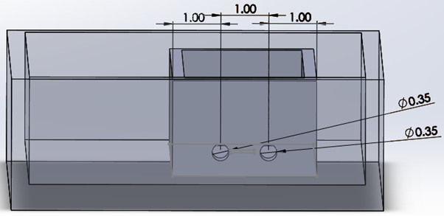
Optical Housing
Components: Lasers, cuvette holder, temperature sensor and detector
Lasers will be placed at an angle and must cross the front surface of the cuvette and reach the detector
Contain the PCB and other electronics such as the display and fans
All measurements are in inches
Top view w/inner and outer box dimensions
Inside view w/inner box dimensions

Slide 42
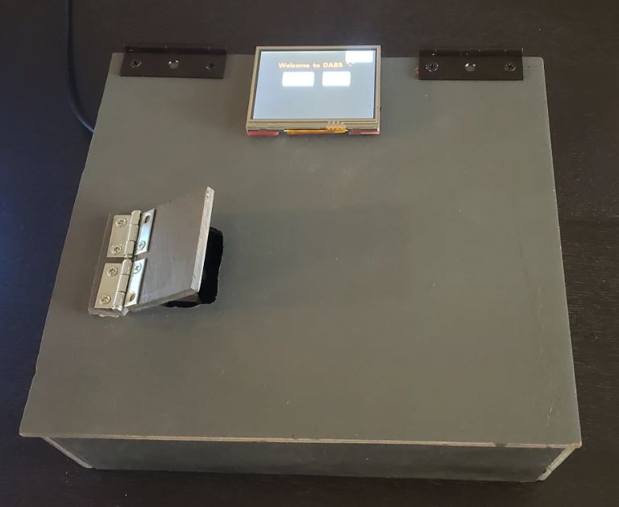
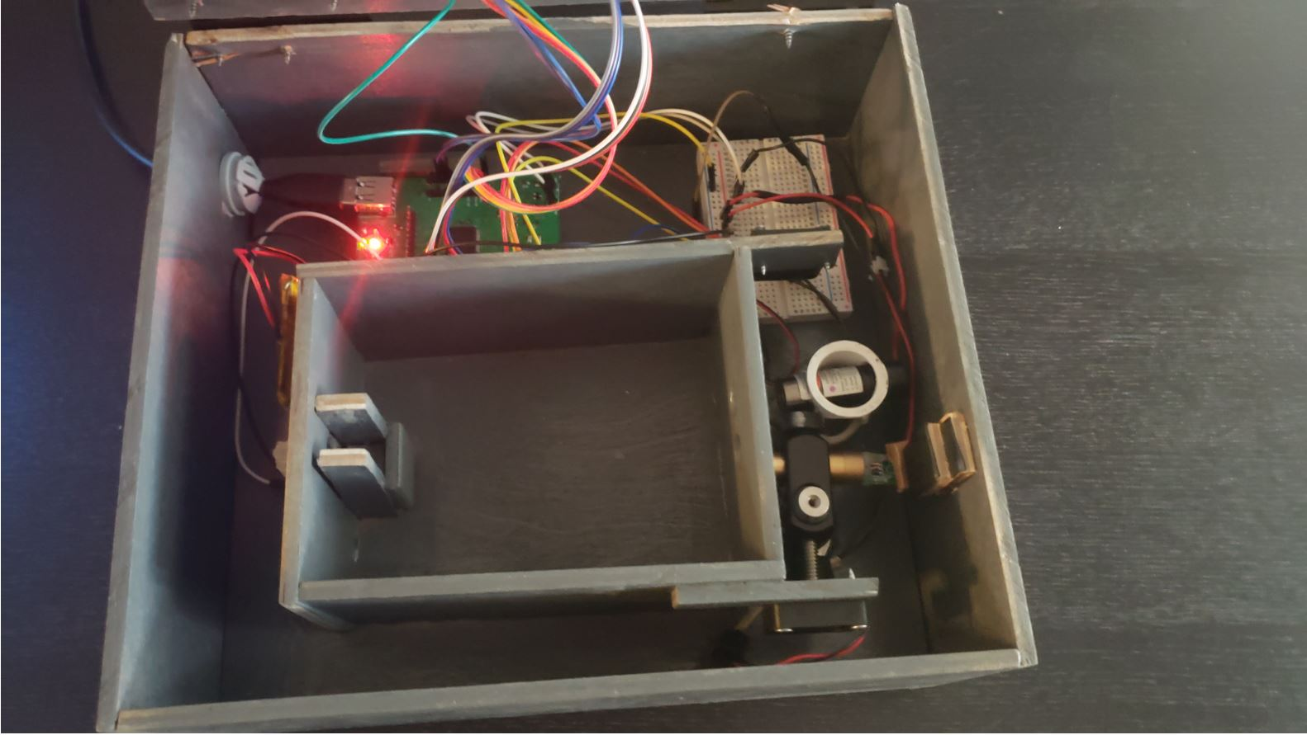
Optical Housing
Outer housing with door for cuvette
Inner housing with all electrical and optical components

Slide 43
Final Specs
# | Specifications | Description | Final Design Specs
1 | USB | USB must supply at least 5 Volts for device usage | 4.99 V
2 | Battery Life | Device must last greater than 1 hour of continuous use | Battery was switched to secondary power source
3 | Light Source | 5 mW 532 nm green laser and 405 nm blue laser diode | 532 nm laser output ~ 5.6 mW 405 nm laser output ~ 4.7 mW
4 | Dimensions | The device should measure no more than 10” x 9” x 9" | ~ 9” x 8” x 4”
5 | PCB | PCB should be < 12 x 12 cm | 6.444 cm x 8 cm
6 | Sample Size | Sample size must be 3 - 4 mL | 3 mL
7 | Optical Sensing Accuracy | Determine 3 boundary ranges of concentrations (Safe, Elevated, Dangerous) | Safe if ≤ 0.36452 0.36452 < Elevated ≤ 0.49794 Dangerous > 0.49794
8 | Weight | The device should weigh < 50 lbs | ~ 4 lbs
9 | Testing of sample | Testing of sample should last no longer than 10 minutes | Avg time for one full test < 1 min 20 sec
10 | Cooling system | Device should be maintained at room temperature (25 ℃ ± 5%) | 24 °C – 26 °C
11 | Cost | This device should cost less than $1000 | ~ $400

Slide 44
Final Results
Sample #1 | Manually Measured Absorbance | DABS Printed Output
1 | .217 | Safe
2 | .385 | Elevated
3 | .857 | Dangerous
The absorbance of each sample was manually calculated using a multimeter to verify DABS results.
After running each sample, DABS correctly identified the safety classification of each sample based on the coded threshold values.

Slide 45
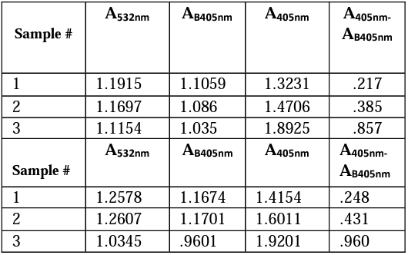
Results
Boundary Ranges
Safe if ≤ 0.36452
0.36452 < Elevated ≤ 0.49794
Dangerous > 0.49794

Slide 46
Administrative Content

Slide 47
Project Budget
System | Part | Actual
Optical | Blue Laser Diode | $40
 | Green Laser Diode | $20
 | Cuvettes | $20
 | Photodetector | $15
 | OpAmp OPA170 | $0*
Power | Battery & Parts | $20
MCU and Screen | MSP430FR6989 80 Pin | $0*
 | LCD Display | $30
PCB | Board | $80
 | BOM (Components) | $65
Temperature Control | Fan | $10
 | Temperature Sensor | $0*
Housing | Acrylic Plastic + Machine Work | $80
Total |  | $385
* = TI Samples

Slide 48
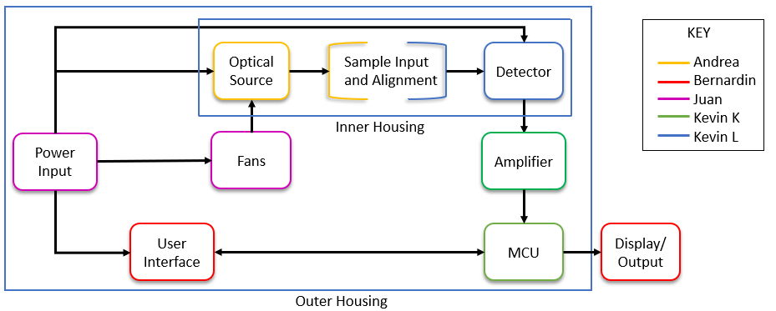
Block Diagram

Slide 49
Responsibilities
 | Andrea | Kevin K | Juan | Bernardin | Kevin L
Power |  | S | P
PCB |  | S | P
Light Source | P |  |  |  | S
Optical Alignment | P |  |  |  | P
Detector | S |  |  |  | P
Amplifier |  | P | S
MCU/Software |  | S |  | P
Display/ Touchscreen |  | S |  | P
Housing | S |  |  |  | P

Slide 50
Future Applications
Necessary modifications for DABS to take bilirubin readings from real human blood serum in a clinical setting are a custom cuvette, different laser diodes, and a recalibration of the hemoglobin estimation.
Cuvette
Lasers
Recalibration
Custom cuvettes with .05 mm pathlengths would reduce the necessary sample size to 4 to 5 drops
Pricier laser modules with built-in high electrical attenuation would reduce noise in the output and increase accuracy.
460 nm and 550 nm would be more optimum wavelengths for bilirubin and hemoglobin.
New absorbance parameters would be inputed at the MCU level

Slide 51
Questions?

